Slide 1
SDM Spice (Jupyter Spice)- Preliminary Design Review
Jeremy Friedrichsen, Jonathan Gibbs, Micah Greenfield, Marc Tchona

Slide 2
Project Overview
Working with SDM EECS department
Open-source circuit design and simulation application
Application will act as an interface for NG-Spice simulation engine
Intended as an alternative to P-Spice, LT-Spice, Multisim, etc.
Focus on new student usability
Suitable for EE120, EE220, EE221, and EE320 with room to expand

Slide 3
Customer Discovery
Need for accessible, open-source circuit simulation tool for educational use
Users require modern graphical interface similar to commercial tools
Integration with documentation systems (LaTeX via Circuitikz) is essential
Demand for extensible architecture that allows customization and plugin development

Slide 4

Needs Assessment
Schematic entry window with component library
  Library includes all components utilized in EE120, EE220, EE221, EE320
Multiple simulation types: Transient, OP, AC Sweep, DC Sweep
Tabular and graphical outputs
Saving/loading capabilities for schematics
Export capabilities for schematics
Export capabilities for netlist
Export capabilities for output

Slide 5
Preliminary Design Description
Splash Page
New Schematic
Load Schematic
Schematic Editor
Run Simulation
Generate Netlist
Send Netlist to NG Spice
Display Results
Receive Results from NG-Spice
NG-Spice Calculates

Slide 6
Technical Details
Framework: Qt (GUI) and Python (backend logic)
Simulator: NGSpice (open source SPICE derivative)
Scientific Computing: NumPy, SciPy, Matplotlib, Pandas
Communication: Inter-process communication via sockets or multithreading
Component Library: SVG, PDF, and PNG schematics following Circuitikz standards

Slide 7
Progress Update
Completed comprehensive requirements specification
Defined system architecture with four modular components
Specified component library requirements (passives, sources, semiconductors, ICs)
Established user interface layout based on modern circuit simulation tools

Slide 8
Engineering Fundamentals and Standards
Circuit theory: Implementation of Kirchhoff's laws through netlist generation
Signal processing: Waveform analysis using FFT and time-domain techniques
Software engineering: Modular design with well-defined APIs and IPC
Standards: Circuitikz for schematic representation, SPICE netlist format

Slide 9
Creativity and Innovation
Modular IPC-based architecture allows independent development and testing of components
Integration with Python scientific ecosystem provides extensibility beyond traditional tools
Direct Circuitikz export enables seamless documentation workflow
Grid-based node mapping simplifies netlist generation and debugging

Slide 10
Risk Assessment
Focus on new users may drive away experienced schematic software users
  Incorporate multiple “levels” of UI that appeal to different users
  Other Spice tools already fulfill experienced user needs
BUT, “a program designed for all is a program designed for none”
  An overfocus on widespread audience could lose sight of the core user
Plan: Design for new user, but leave room for audience expansion

Slide 11
Test and Verification Plans
Unit testing: Individual component functionality (schematic elements, waveform generation)
Integration testing: IPC communication between modules, netlist generation accuracy
Simulation validation: Compare NGSpice results with known circuit behaviors
Tools: pytest for Python testing, Qt Test framework for GUI testing

Slide 12
Project Timeline
Phase 1: Schematic Design Tool (8 weeks) - Grid canvas, basic components, netlist generation
Phase 2: Circuit Simulator Integration (4 weeks) - PySpice wrapper, simulation modes
Phase 3: Waveform Generator (3 weeks) - Signal types, parameter controls
Phase 4: Oscilloscope Tool (3 weeks) - Time/frequency plots, data export
Phase 5: Integration & Testing (4 weeks) - IPC setup, end-to-end testing

Slide 13

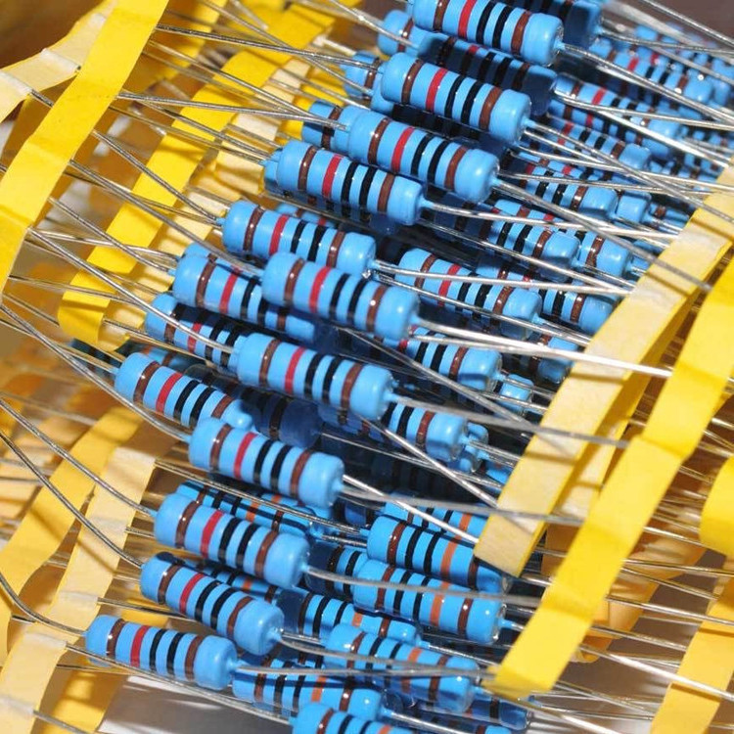
Budget Estimate
No money spent yet
Potential AI usage Plan
  ~$20/mo -> $120 upper limit
Circuit components for testing
  ~$100 expected upper limit
  May be able to source from department
Expected maximum of ~$220

Slide 14
Demo or Prototype
Current status: Design phase complete, ready for implementation
Planned prototype: Basic schematic editor with simple RC circuit simulation
Demo deliverables: Grid-based canvas, component placement, netlist output, basic NGSpice integration

Slide 15
Q&A

